Slide 1

Global Business Today 9e
by Charles W.L. Hill
and Tomas Hult

Slide 2
Chapter 1
Globalization

Slide 3
Learning Objectives
The learning objectives for this chapter are to:
  Understand what is meant by the term globalization.
  Recognize the main drivers of globalization.
  Describe the changing nature of the global economy.
  Explain the main arguments in the debate over the impact of globalization.
  Understand how the process of globalization is creating opportunities and challenges for business managers.

Slide 4
Introduction
In the world economy today, we see:
  Fewer self-contained national economies with high barriers to cross-border trade and investment
  A more integrated global economic system with lower barriers to trade and investment
  Over $5 trillion in foreign exchange transactions daily
  Over $18 trillion of goods and $4 trillion of services being sold across national borders
  The establishment of international institutions
Notes:
Internet Extra: The U.S. Census Bureau contains monthly statistics on trade between the United States and its trading partners. The web site is {http://www.census.gov/foreign-trade/top}.
Click on Trade Highlights.
Who is the top trading partner for the U.S.?
What is the top destination for U.S. goods?
What country exports the most to the U.S.?

Slide 5
What Is Globalization?
Question: What is globalization?
Answer:
Globalization refers to the trend towards a more integrated global economic system
Two key facets of globalization are:
  The globalization of markets
  The globalization of production

Slide 6
The Globalization of Markets
Globalization of markets - the merging of historically distinct and separate national markets into one huge global marketplace
In many markets today, the tastes and preferences of consumers in different nations are converging upon some global norm
  Coca Cola, Citigroup credit cards, McDonald’s hamburgers, and IKEA furniture

Slide 7
The Globalization of Production
Globalization of production - the sourcing of goods and services from locations around the globe to take advantage of national differences in the cost and quality of factors of production (labor energy, land, and capital)
Goal:
  Lower overall cost structure
  Improve the quality or functionality of the product to gain competitive advantage
Notes:
Management Focus: Vizio and the Market for Flat Panel TVs
Summary
This feature explores the evolution of the flat panel television industry over recent decades. While the technology for flat panel televisions was developed in the United States in the 1960s, virtually all production now takes place in low-cost locations. The feature examines the strategy of one company, American-based Vizio, and clearly demonstrates the impact of globalization, and in particular the globalization of production.
Suggested Discussion Questions
1. Why is the manufacturing of flat panel TVs migrating to different locations around the world? Who benefits from the globalization of the flat panel industry? Who are the losers?
2. What does the example of Vizio tell you about the future of production in an increasingly integrated global economy? What does it tell you about the strategies that enterprises must adopt in order to thrive in highly competitive global markets?
Discussion Points:
1. The market for flat panel televisions is huge. Sales have grown from virtually nothing to more than $2 billion in 2010. However, competition is intense forcing producers to continually look for new ways to cut costs. In their quest for efficiency, most manufacturers have developed global supply chains. American-based Vizio for example, outsources to various suppliers around the globe. Panels come from South Korea, components from China, and processors from the United States. Then, assembly takes place in Mexico. The goal for Vizio is to find the best source, wherever it may be, and bring all the pieces together. Consumers are clearly benefiting from the globalization of the flat panel television market. Thanks to the intense competition in the industry, prices have fallen dramatically. However, because manufacturers are continually looking for ways to cut costs and become more efficient, production changes and outsourcing is common, if not necessary, making jobs in the industry precarious.
2. Vizio could be considered a model of how to conduct business in a highly competitive global market. Vizio’s strategy involves a realization that there is no single best production location. Instead, production should take place wherever it makes the most sense. To that end, the company has broken the value chain for the flat panel television into those parts that must be kept at home, and those that can be outsourced. Vizio, with a staff of just 100 people, outsources most engineering work, all of its manufacturing, and nearly all of its logistics. As the example with Vizio demonstrates, flexibility, speed, and innovativeness are all important qualities for successful firms in highly competitive global markets. Vizio is never satisfied with the status quo. To remain competitive, Vizio continually looks for better ways to produce its product.
Teaching Tip: To extend this discussion, consider {http://www.businessweek.com/news/2012-01-11/vizio-aims-low-price-wrecking-ball-at-pcs-after-shaking-up-tvs.html}.

Slide 8
The Emergence of Global Institutions
Global institutions:
  Manage, regulate, and police the global market place
  Promote the establishment of multinational treaties to govern the global business system
  The World Trade Organization (WTO) - polices world trading system and ensures nations adhere to the rules established in WTO treaties (After Uruguay Round)
    Succeeded the General Agreement on Tariffs and Trade (GATT)
    In 2013, its 159 members accounted for 98% of world trade
Notes:
Internet Extra: To learn the status of current trade issues, “hot” areas of international trade, and the responsibilities of the WTO, go to {http://www.wto.org/}.
Review the issues that are currently at the top of the agenda for the WTO.
Do they affect developed countries or developing countries? What are their implications for global trade?
Go to Trade Topics. Click on Disputes Gateway. Explore the disputes currently under review. How do you think they will be resolved? Why?

Slide 9
The Emergence of Global Institutions
(continued from Slide 1-8)
  The International Monetary Fund (IMF) -
The World Bank - promotes economic development using low-interest loans
The United Nations (UN) -
  Maintains international peace and security
  Develops friendly relations among nations
  Cooperates in solving international problems
  Promotes respect for human rights
  Is a center for harmonizing the actions of nations

Slide 10
Drivers of Globalization
Question: What is driving the move toward greater globalization?
Answer:
Declining trade and investment barriers
Technological change

Slide 11
Declining Trade and Investment Barriers
International trade occurs when a firm exports goods or services to consumers in another country
Foreign direct investment (FDI) occurs when a firm invests resources in business activities outside its home country
  During the 1920s and 1930s, many nations erected barriers to international trade and FDI to protect domestic industries from foreign competition

Slide 12
Declining Trade and Investment Barriers
(continued from Slide 1-11)
After WWII, advanced Western countries began removing trade and investment barriers
  Under GATT, nations negotiated decreases in tariffs and made significant progress on a number of non-tariff issues
The WTO:
  Provides a mechanism for dispute resolution and the enforcement of trade laws
  Is focusing on cutting tariffs on industrial goods, services, and agricultural products
  Is reducing barriers to cross-border investment

Slide 13
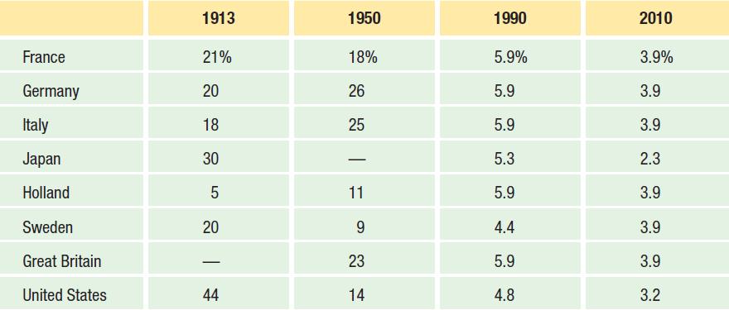
Declining Trade and Investment Barriers
(continued from Slide 1-12)
Average Tariff Rates on Manufactured Products as a Percent of Value

Slide 14
Declining Trade and Investment Barriers
(continued from Slide 1-13)
Lower trade and investment barriers help companies:
  See the world as a single market
  Establish production activities in optimal locations around the globe
This has led to an acceleration in the volume of world trade and investment
  Companies now disperse production to drive down production costs and increase product quality
  Economies of nation-states are becoming more intertwined

Slide 15
Role of Technological Change
Since World War II, there have been major advances in communication, information processing, and transportation
  The microprocessor - lowered the cost of global communication and the cost of coordinating and controlling a global organization
  The Internet
    2.4 billion Internet users in 2012
    Global e-commerce sales over $1 trillion in 2012
  Commercial jet aircraft, super freighters and containerization (lowered shipping costs)
    Simplifies mode to mode trans-shipment

Slide 16
Role of Technological Change
(continued from Slide 1-15)
Question: What are the implications of technological change for the globalization of production?
Answer:
Lower transportation costs:
Make a geographically dispersed production system more economical
Allow firms to better respond to customer demands

Slide 17
Role of Technological Change
(continued from Slide 1-16)
Question: What are the implications of technological change for the globalization of markets?
Answer:
Low cost communications networks help create electronic global marketplaces
Low cost transportation:
  Enables firms to create global markets
  Facilitates the movement of people promoting a convergence of consumer tastes and preferences

Slide 18
Changing Demographics
In the 1960s:
  The U.S. dominated the world economy, world trade, and world FDI
  U.S. MNEs dominated the international business scene
  About half the world-- the centrally planned economies of the communist world-- was off limits to Western international business
Today, much of this has changed
Notes:
Country Focus: India’s Software Sector
Summary
This feature explores the growth of India’s software industry. Starting from nothing just twenty-five years, the industry now generates revenues of nearly $40 billion, and exports of $31.3 billion. With global spending on information technology expected to be some $260 billion in 2009, Indian companies are primed to capture a significant share of the pie, forcing their Western counterparts to make changes to their strategies.
Suggested Discussion Questions
1. What factors have contributed to the growth of India’s software industry?
Discussion Points: Four key factors have contributed to the growth of India’s software industry. First is the huge number of engineers in India. Some 400,000 engineers graduate from Indian universities every year. A second factor is India’s low wage structure. Indian engineers make about 12 percent of what an American colleague might make. Third, coordination between Western firms and Indian firms is facilitated by the large number of English-speaking Indians. Finally, because of the differences in time zones, Indian firms operate while American firms are closed.
2. How has India’s software industry changed in recent years? What are the implications of these changes for American companies like IBM and Microsoft?
Discussion Points: There has been a gradual shift in the Indian software industry in recent years. Initially, Indian firms focused on the low end of the industry to supply basic software development and testing services to Western firms. Today however, many companies have moved into higher end services to compete for large software development projects, business outsourcing contracts, and information technology consulting services. This new competitive threat is forcing American firms like IBM and Microsoft to rethink their global strategies. Some Western companies are now investing in India with the goal of capturing some of the cost advantages Indian companies like Infosys and Wirpro enjoy.
Lecture Note: India’s smartphone industry is growing rapidly and Google is just one company that is looking to capitalize on this growth. To learn more, go to {http://www.businessweek.com/articles/2014-10-21/googles-big-plans-for-low-cost-android-one-phones-in-india}.
Video Note: The iGlobe India's Economy Remains Robust Despite Global Downturn examines India’s economic strength even during the recent global recession.

Slide 19
Changing World Output
In the early 1960s:
  U.S. - dominant industrial power accounting for about 38.3% of world manufacturing output
By 2012:
  U.S. accounted for only 23.1% (Major decline from 1960)
  Germany, France, and the U.K. had a similar decline
  Rapid economic growth now in countries like China, India, Russia, and Brazil
  Further relative decline by the U.S. is likely
So companies may find both new markets and new competitors in the developing regions of the world

Slide 20
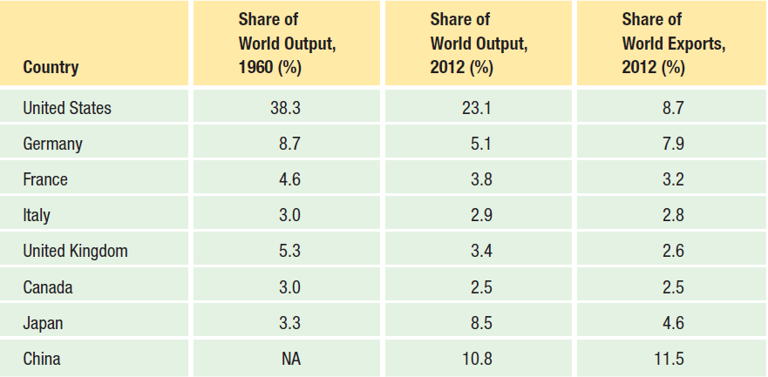
Changing World GDP and Trade
The Changing Demographics of World GDP and Trade

Slide 21
Changing FDI Picture
The share of world output generated by developing countries has been steadily increasing since the 1960s
  The stock of foreign direct investment (total cumulative value of foreign investments) generated by rich industrial countries is declining
  Cross-border flows of foreign direct investment are rising
  The largest recipient of FDI is China, followed by Brazil, Mexico, and China

Slide 22
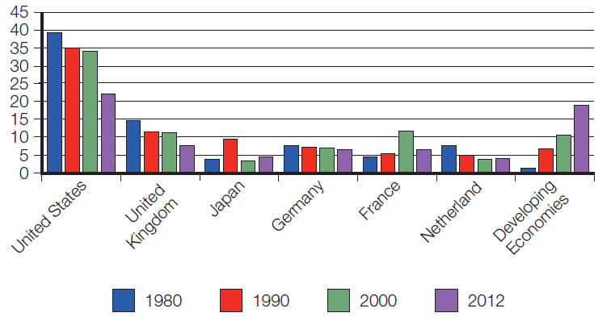
Changing FDI Picture
(continued from Slide 1-21)
Percentage Share of Total FDI Stock, 1980 - 2012

Slide 23
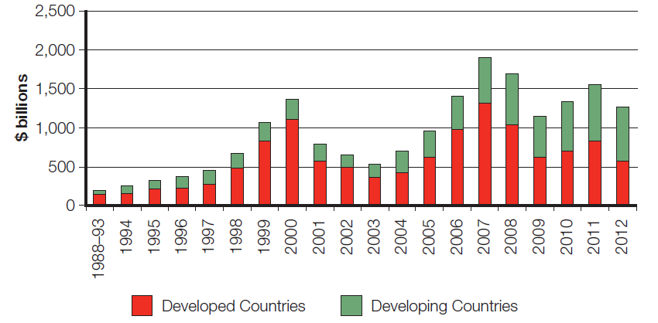
Changing FDI Picture
(continued from Slide 1-22)
FDI Inflows, 1988 - 2012

Slide 24
The Changing MNE
A multinational enterprise (MNE) is any business that has productive activities in two or more countries
Since the 1960s:
  There has been a rise in non-U.S. multinationals
  There has been a rise in mini-multinationals
Small and medium-size firms are now expanding internationally
  Easier to build international sales via the Internet
Notes:
Management Focus: China’s Hisense – An Emerging Multinational
Summary
This feature examines the growth of Hisense which began in 1969 as a state-owned factory with just 10 employees. Over the years, the company emerged as one of China’s leading makers of television sets. In 1994, China relaxed its hold on the company and Zhou Houijan was appointed CEO. Under Zhou’s leadership Hisense has become as one of China’s premier manufacturers of consumer appliances and telecommunications equipment.
Suggested Discussion Questions
1. What makes Hisense different from other manufacturers of consumer electronics? What factors have contributed to its success?
Discussion Points: The success of Hisense can be attributed to not only its low cost structure, but also the company’s skill in product innovation. In fact, Hisense believes that its main strength is its rapid production innovation. The company feels that to be successful in the highly competitive consumer electronics industry, it must be on the cutting edge of innovation. Consequently, the company’s strategy is to continuously launch advanced, high quality, and competitively priced products.
2. Why has Hisense established multiple R&D centers? How do these R&D centers fit into the firm’s global strategy?
Discussion Points: In 1994, Hisense established its first R&D center in China. Since then, the company has also established R&D centers in South Africa and Europe, and is scheduled to open an R&D center in the United States in the near future. Being innovative is central to Hisense’s strategy.
Having multiple R&D centers allows Hisense to be closer to its markets, and should help the company better serve customer needs and preferences.
Teaching Tip: To learn more about Hisense go to {http://www.hisense.com/} and click on English.

Slide 25
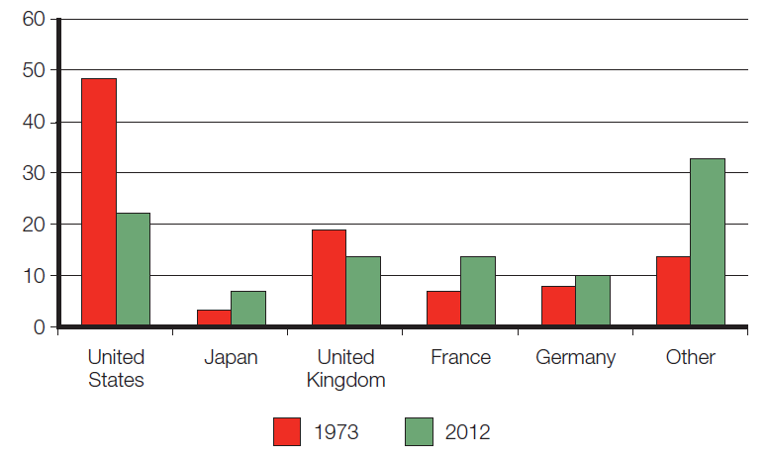
The Changing MNE
(continued from Slide 1-24)
  National Share of Largest Multinationals, 1979 and 2012

Slide 26
The Changing World Order
The collapse of communism in Eastern Europe
  Greater export and investment opportunities, but political unrest is increasing risk
Economic development in China
  Huge opportunities despite continued government control, but also new competition from Chinese firms
Free market reforms and democracy in Latin America
  New markets and new sources of materials and production, but economic and political risk remains high

Slide 27
Global Economy in the 21st Century
A more integrated global economy
  New opportunities for firms
  But, political and economic disruptions can throw plans into disarray

Slide 28
The Globalization Debate
Question: Is the shift toward a more integrated and interdependent global economy a good thing?
Answer:
Many experts believe that globalization is promoting greater prosperity in the global economy, more jobs, and lower prices for goods and services
Others feel that globalization is not beneficial

Slide 29
Anti-globalization Protests
Question: What are the concerns of critics of globalization?
Answer:
Anti-globalization protesters fear that globalization is forever changing the world in a negative way
  They believe that globalization negatively affects living standards and the environment
Evidence suggests their fears are exaggerated

Slide 30
Globalization, Jobs, & Income
Many believe U.S. jobs are being lost to low-wage nations
Supporters claim while some jobs may be lost, the economy as a whole is better off
Free trade will result in countries:
    Specializing in the production of those goods and services that they can produce most efficiently
    Importing goods and services that they cannot produce as efficiently
  In doing so, all countries will gain
    Invest in education to improve labor skills and increase wages
Notes:
Country Focus: Protesting Globalization in France
Summary
This feature describes the anti-globalization protests going on in France. The protests, led by activist Jose Bove, started when the U.S. retaliated against EU bans on beef imports by imposing a 100% tariff on some EU products. Bove and his associates targeted McDonald’s, and also California winemaker Mondavi as symbols of their opposition to American investments. Still, despite the protests, foreign investment in France is at record highs, and ironically, so are French investments abroad.
Suggested Discussion Questions
1. Consider the trade war that initiated the protests led by Bove. The EU instituted restrictions on the import of hormone treated beef because it was feared that the product might lead to health problems. The WTO stated that the restrictions were prohibited under WTO agreements and ordered the EU to lift the restrictions or face retaliatory measures. In your opinion, did the WTO act appropriately? Should a government be permitted to make decisions as to what products are or are not available to consumers? Should the WTO? What do you think would have happened if the WTO had ruled in favor of the EU?
Discussion Points: Many students will probably argue that the European Union’s restrictions against hormone treated beef were nothing more than thinly veiled protectionism. Accordingly, students will probably feel that the World Trade Organization was justified in its ruling. Some students however, may suggest that the European Union was looking out for its citizens when it instituted the bans, and that therefore the World Trade Organization was overstepping its bounds.
2. Why was McDonald’s chosen as the target for anti-globalization protests? How can companies like McDonald’s protect themselves from the actions of protesters like Bove?
Discussion Points: Students will probably recognize that as an icon of the United States, McDonald’s is a symbol of America and as such was a natural target for protesters. The fact that its menu is based on beef was probably an added bonus. Many students will note that companies that are actively involved in local communities are less likely to attract negative feeling than those that are not. Students might recommend that companies like McDonald’s work to ingratiate themselves with the host country through charitable programs, social activities, and so on.
Lecture Note: For more on this case, see Chapter 6’s Country Focus: Trade in Hormone-Treated Beef.
Teaching Tip: To learn more about ongoing WTO disputes, go the WTO’s homepage: {www.wto.org}.
Video Note: Protesting against globalization is not uncommon. The iGlobe Environmental Activist Questions the Goals of Globalization also explores the negative effects of globalization.

Slide 31
Globalization, Labor Policies, Environment
Critics argue free trade encourages firms from advanced nations to move manufacturing facilities offshore to less developed countries with lax environmental and labor regulations
Supporters claim tougher environmental regulation and stricter labor standards reflect economic progress
    As countries get richer as a result of globalization, they raise their environmental and labor standards
    Free trade does not lead to more pollution and labor exploitation, it leads to less

Slide 32
Globalization and National Sovereignty
Critics worry economic power is shifting away from national governments and toward supranational organizations such as the WTO, the European Union (EU), and the UN
Supporters argue that the power of these organizations is limited to what nation-states collectively agree to grant
  The organizations must be able to persuade members states to follow certain actions
  Without the support of members, the organizations have no power

Slide 33
Globalization and the World’s Poor
Critics argue the gap between rich and poor has gotten wider and the benefits of globalization have not been shared equally
Supporters suggest that the actions of governments have made limited economic improvement in many countries
  Many of the world’s poorest nations are under totalitarian regimes, suffer from endemic corruption, have few property rights, are involved in war, and are burdened by high debt

Slide 34
Managing in the Global Marketplace
Question: What does the shift toward a global economy mean for managers within an international business?
Answer:
Managing an international business (any firm that engages in international trade or investment) differs from managing a domestic business in four key ways

Slide 35
Managing in the Global Marketplace
(continued from Slide 1-34)
Country differences require companies to vary their practices country by country
Managers face a greater and more complex range of problems
International companies must work within the limits imposed by governmental intervention and the global trading system
International transactions require converting funds and being susceptible to exchange rate risk

Slide 36
Summary
In this chapter we have:
  Explored what is meant by the term globalization.
  Identified the main drivers of globalization.
  Described the changing nature of the global economy.
  Explained the main arguments in the debate over the impact of globalization.
  Discussed how the process of globalization is creating opportunities and challenges for business managers.

